Slide 1
MPPT Solar Charge Controller Circuit
Abhi Kamboj

Slide 2
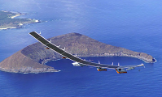
UIUC Applied Aerodynamics Group
Research under Or Dantsker
Group’s goal:
Create self powered Unmanned Ariel Vehicle (UAV)
Non-stop flight

Slide 3
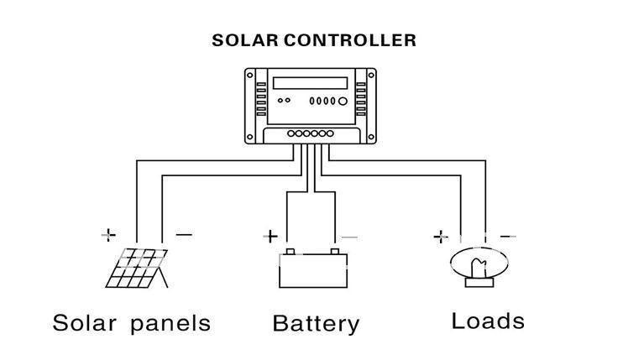
My Project:
Old UAV system is being updated with a new battery with more power
Need to redesign charge controller circuit
Controls how solar panels charge battery
Controls how power is given to rest of system from battery

Slide 4
Research Outline
Background Study
Implementation
Testing and Improvement
Hands on Practice with circuit
Circuit Design (Eagle CAD)

Slide 5
Problem with Solar Output:
Solar Panels don’t output the maximum power automatically
Power depends on load impedance, weather, sunlight, irradiation, etc.
Solar panels perform better in cold weather (provide more energy)
And worse in warm weather
Voltage and current output of solar panels rarely match the battery specifications, so lots of power can get wasted!
Notes:
https://www.solar-electric.com/learning-center/batteries-and-charging/mppt-solar-charge-controllers.html

Slide 6
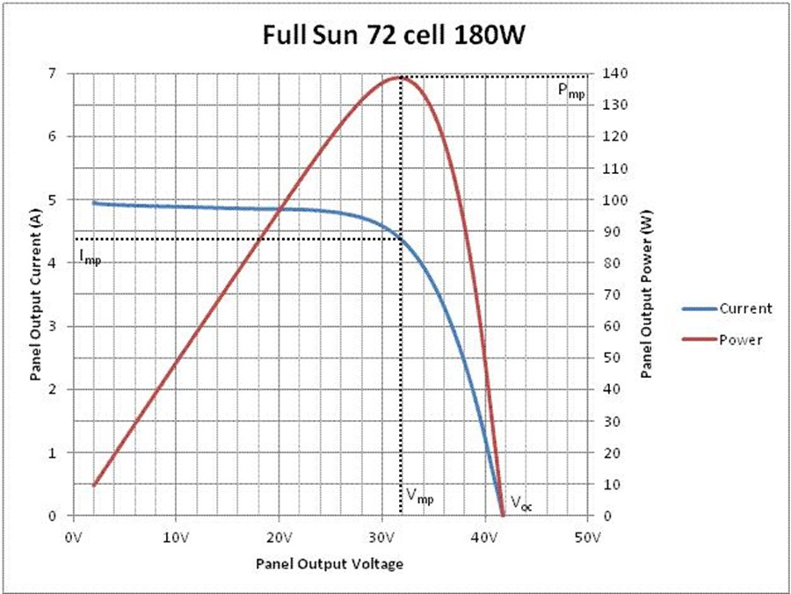
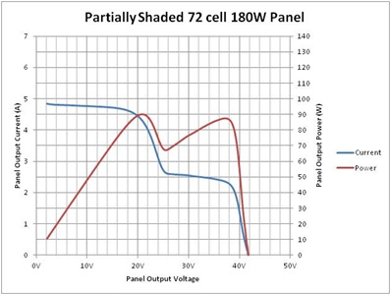
Maximum Power Point Tracking
An algorithm that solar charge controllers use to extract the maximum amount of power from a solar panel
Varies the impedance to find the current and voltage for when the maximum power is being outputted to the battery
Uses DC to DC converter to make the panel output match the best current and voltage
Notes:
https://www.solar-electric.com/learning-center/batteries-and-charging/mppt-solar-charge-controllers.html

Slide 7
MPPT Charge Controller Example:
130 Watt solar panel, 17.6V 7.4A
Connected to a 12 V battery→ 12*7.4=88.8 W power
Lost 41.2 W of power!
MPPT would increase the current and decrease the voltage to get more power into battery
MPPT might convert solar panel output down to 12V * 10.6A→ ~129 W, which is a much better output
MPPTs especially helps with varying climate and low battery charge.
Notes:
https://www.solar-electric.com/learning-center/batteries-and-charging/mppt-solar-charge-controllers.html

Slide 8
MPPT Techniques:
Perturb and Observe
Adjust voltages and observe max power output
Incremental Conductance (I/V is conductance)
P=VI, and I is a function of V, so dP/dV=VdI/dV+I (product rule)
Max power when dP/dV=0, so -VdI/dV=I, or dI/dV = -I/V
So measure changes in current and voltage and when I_{Δ} / V_{Δ} is equal to I/V, you are at max power
Current Sweep
Adjust current and obtain IV characteristic, then determine max power
Notes:
https://en.wikipedia.org/wiki/Maximum_power_point_tracking

Slide 9
MPPT Techniques cont.
Constant Voltage
Occasionally measure open circuit voltage (V_{OC}) and keep output voltage (V) at some ratio of that voltage (like V/V_{OC} =.76). This is ratio obtained empirically
Temperature
Maximum power point is mostly dependent on temperature, so measure temperature and use an empirically determined equation like the following to determine max power.
Notes:
https://en.wikipedia.org/wiki/Maximum_power_point_tracking

Slide 10
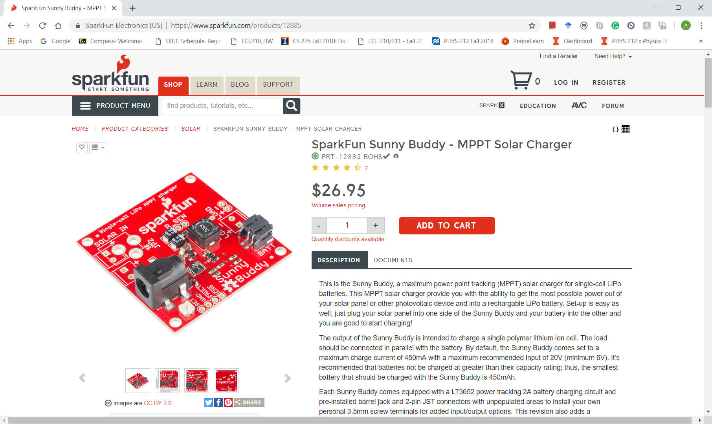
Sparkfun Kit

Slide 11
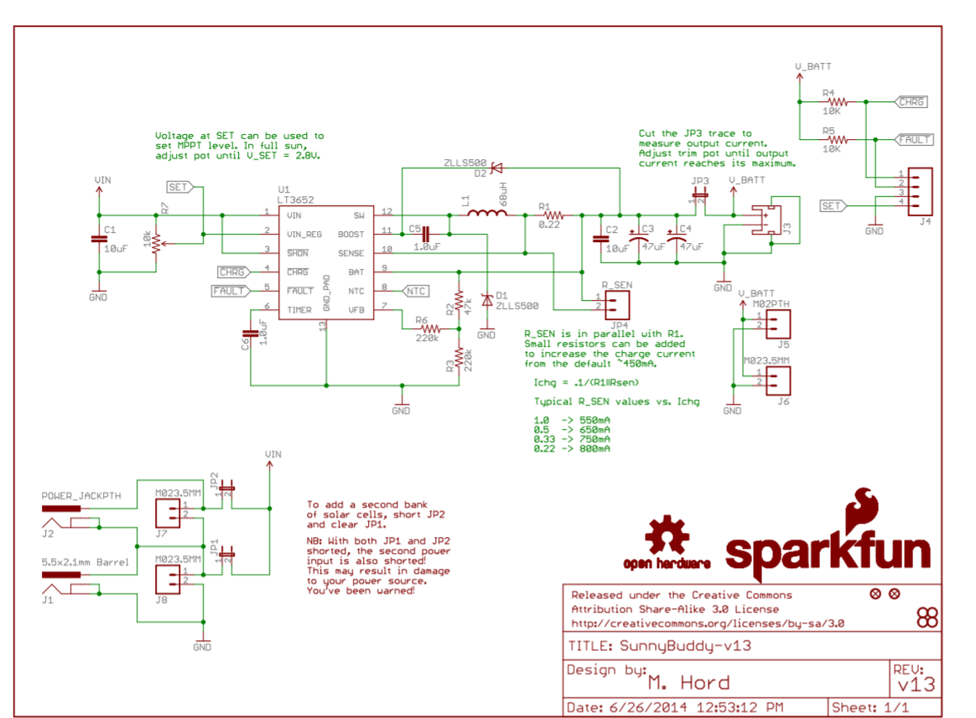
Data Sheet and Schematic

